Slide 1




21.06 Release
@RAPIDSai
https://github.com/rapidsai
https://rapids-goai.slack.com/join
https://rapids.ai
Notes:
https://rapids.ai/ https://github.com/rapidsai
https://docs.rapids.ai/overview

Slide 2
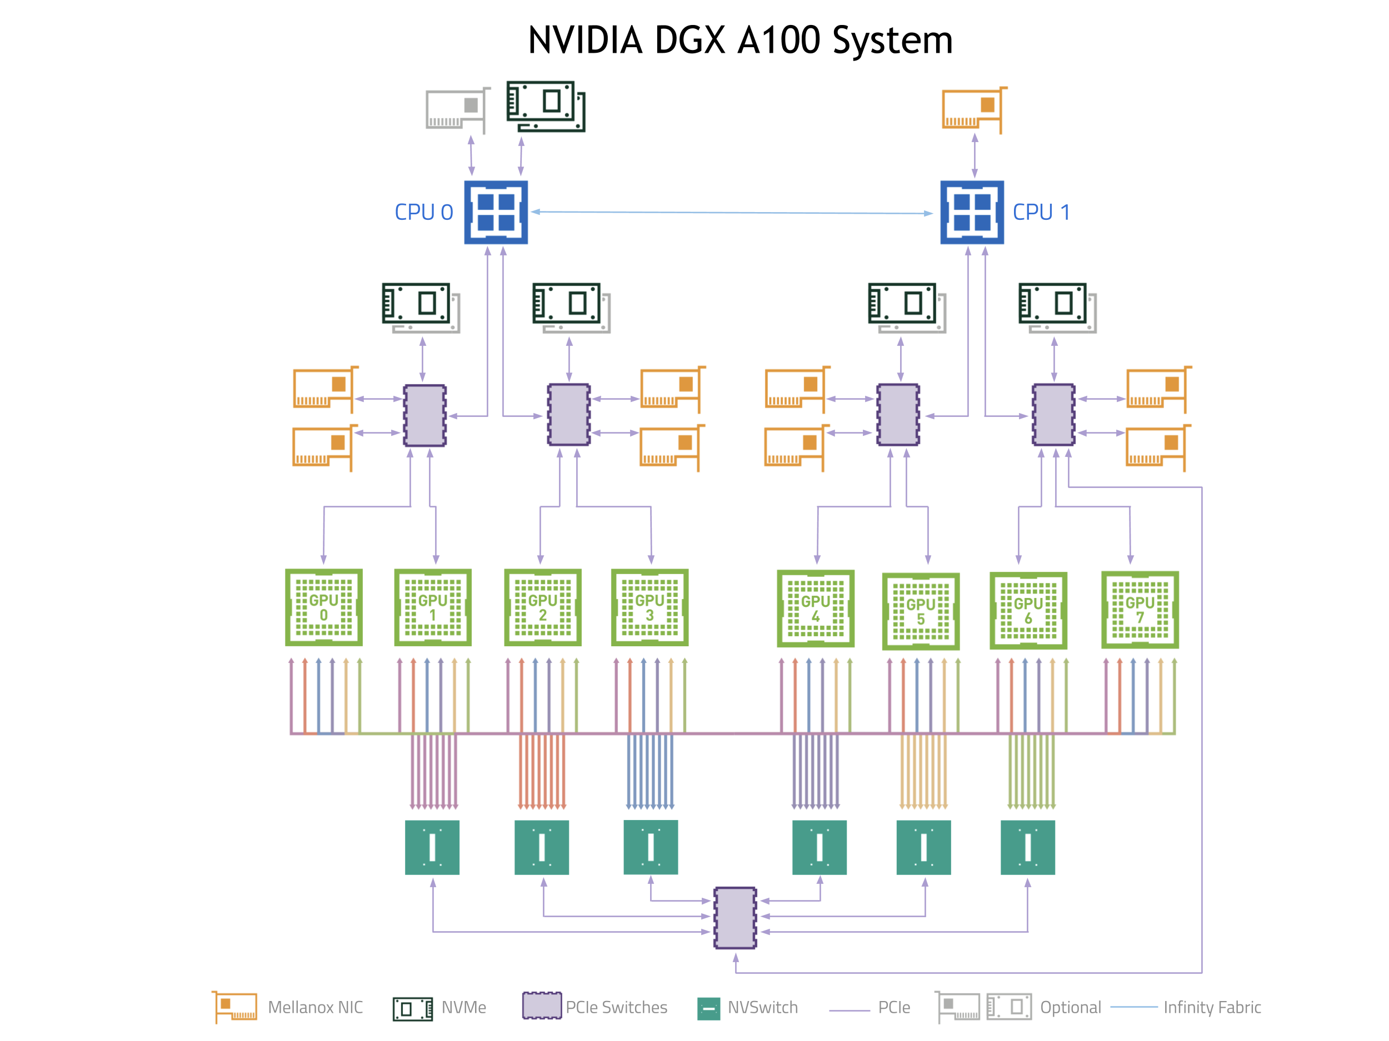
Why GPUs for Data Science?
Numerous hardware advantages
Thousands of cores with up to ~20 TeraFlops of general purpose compute performance
Up to 1.5 TB/s of memory bandwidth
Hardware interconnects for up to 600 GB/s bidirectional GPU <--> GPU bandwidth
Can scale up to 16x GPUs in a single node
Almost never run out of compute relative to memory bandwidth!

Slide 3
What is RAPIDS?
End-to-End GPU Accelerated Data Science
Data Preparation/ETL
Analytics/ML/Graph
Visualization
cuDF
GPU-accelerated ETL functions
Tracks pandas and other common PyData APIs
Dask + UCX integration for scaling
cuML
GPU-native ML library, including XGBoost, FIL, HPO, and more
cuGraph
GPU graph analytics, including TSP, PageRank, and more
cuxfilter
GPU-accelerated cross-filtering
pyViz integration
Plotly Dash, Bokeh, Datashader, HoloViews, hvPlot
Domain-Specific Libraries
CLX + Morpheus Cyber log processing + anomaly detection | cuSignal Signals processing | cuSpatial Spatial analytics
cuStreamz Streaming analytics | cuCIM Computer vision & image processing primitives | node-RAPIDS Bindings for node.js
...and more!

Slide 4
Overview of Changes: RAPIDS 21.06 Release
RAPIDS+Dask Updated memory spilling (JIT_UNSPILL) to use compatibility mode; added capability to benchmarks; added support for CUDA Async Memory Resource; UCX usability improvements including clean endpoint shutdown and documentation;
cuDF Additional support for fixed-point decimal types in Python; more groupby and join aggregations; more functionalities for list and string type operations in Python; expanded dictionary type operations in C++;
cuML New HDBSCAN model; major improvements to Random Forest; single-linkage hierarchical clustering; sample weights for logistic regression; major improvements to build system;
XGBoost 1.4.2 ships with 21.06, including improvements to Dask integration and prediction functions;
cuGraph Single and Multi GPU Weakly Connected Components; graph batching for C++; multi-column support; Bipartite graph structures; continued improving graph primitives for performance
CLX URL processing for DGA detection; added Multiclass Sequence Classifier; enhanced Lightweight Online Detector of Anomalies
cuCIM Multiple GPU accelerated computer vision and image processing primitives for N dimensional images
Morpheus using RAPIDS libraries; early access available on June 15th 2021

Slide 5
cuDF Updates: Deep Dive
Release 21.06
Features added in 21.06
Decimal data type is now supported for csv and orc writer functions in Python
Shift and multiple cumulative operations for groupby aggregation are now available
Add join_list_elements, getitem, concatenate_list_elements functions to List
Updates and enhancements of multiple string functionalities
Planned Upcoming Features
Conditional Joins
Decimal support for additional cuIO functions
ORC GDS and struct support
Update to Arrow 4.0.1
Support multiple inputs in json reader
Notes:
Medium blog title : Lookout, nested types are now supported in RAPIDS cuDF!

Slide 6
cuML Updates: Deep Dive
Release 21.06
Features added in 21.06
New Hierarchical Density-Based Spatial Clustering of Applications with Noise (HDBSCAN) algorithm
Fast Fourier Transform accelerated t-Stochastic Neighborhood Embedding (FIt-SNE)
New backend to use cuML’s Forest Inference Library (FIL) in the NVIDIA Triton Inference Server.
Added ColumnTransformer and FunctionTransformer functions to cuML’s preprocessing module
New Random Forest backend is the default both classification and regression models - provides better performance and accuracy
Many model-specific improvements! ARIMA memory improvements, deterministic mode for UMAP, sample weights for logistic regression, ....
Planned Upcoming Features
Further enhancements for Random Forest, Forest Inference Library and HDBSCAN
Sparse Logistic Regression
Weighted multi-node multi-gpu KMeans

Slide 7
cuGraph Updates: Deep Dive
Release 21.06
Features added in 21.06
New Multi GPU implementation of Weakly Connected Components
Graph Batching functionality added to libcugraph
Multi-column support for all cuGraph algorithms
Bipartite graph structures are now supported in cuGraph
New padded result set for Random Walk
Planned Upcoming Features
Depth limit functionality on traversal algorithms
Batch Random Walk
Multi-Seed Breadth First Search
Aggregated Traversal Graph Prim

Slide 8




Join the Conversation
GOOGLE GROUPS
DOCKER HUB
SLACK CHANNEL
STACK OVERFLOW
https://groups.google.com/forum/#!forum/rapidsai
https://hub.docker.com/r/rapidsai/rapidsai
https://rapids-goai.slack.com/join
https://stackoverflow.com/tags/rapids

Slide 9
THANK YOU
@RAPIDSai
Notes:
https://rapids.ai/ https://github.com/rapidsai
https://docs.rapids.ai/overview

